Slide 2
1.Karie的在等待老师批卷的紧张心情.
With her fingers crossed, Karie sat restlessly in her seat.
Her finger crossing, Karie sat restlessly in her seat
2.Karie回家时的激动心情
Mom asked as Karie burst through the front door. Karie didn’t answer.
As if by magic, she took out her spelling test paper and prize and showed them to her mother.
3.Karie发现拼写错误时吃惊的心情
Her hands stopped in the mid air.
4Karie复杂不安的心情
Karie stuffed/squeezed the test paper into her backpack and explained she was just too excited.

Slide 3
5. After drinking a little, she plodded /dragged down the hall, lost in thought. How could she tell the class she hadn’t earned the prize after all?
使用动词plod刻画了Karie的沉重心情而心里描写则体现了她的矛盾心里。
6.She paced up and down in her room with her face twisting with pain.
7.She lay in bed, wide awake.
8. She couldn’t fall asleep , tossing and turning in bed for a
whole night.

Slide 4
Krin spotted some peices of seashells lying scatted on the picturesque beach and some holes stretching along it where the crabs had hidden.
sunshine with scattered showers.
The front steps to the doorway of the house creaked as they carefully climbed up them, so did the porch when they stepped onto it. The dusty windows and porch railing were badly weathered and broken. The front door was half open so they squeezed through and cautiously entered. The place was in a total mess, covered with dust, sand, dead leaves, and overturned furniture. They’d taken but a few steps when the door unexpectedly slammed shut behind them.

Slide 5
Scared, Krin and Paula were frozen to the spot. But before they could even utter something like “Oh-Oh”, the window abruptly closed. And as if this wasn't scary enough, the stairs to the second floor creaked loudly. When a light in the back bedroom flickered, that was absolutely the final straw.

Slide 6
Frozen with fear, Paula was too scared to move an inch.
Seized by a huge surge of panic, she remained motionless.
She was so scared that her mouth went dry.
Instantly a sense of terror crept upon him rippling across(spreading through) his while body. He felt every single hair stood on end.
To include details of people’s physical and mental response.

Slide 7
----“Hey, bro, look over there in the back bedroom, the window is open.” whispered Paula.
----“Yeah, hurry up, let’s jump out of it.” nodded Krin.
To properly and naturally use dialogues.
.

Slide 8
At that critical moment, the survival skills learned at school flashed across his mind. “Yeah, that’s a good idea,” his face lit up.
Desperate and hopeless, they felt as if the world came crashing down. Then suddenly Mom’s encouraging words echoed in his brain, a ray of hope flickering in her eyes. ”I shouldn’t give up easily,” Krin determined.
To include mental activities.

Slide 9
Without the slightest hesitation, Krin grabbed his sister’s hand and dashed into the back room.
Hand in hand, they cautiously tiptoed to the back room. Unluckily, Krin tripped and fell before they got out of the haunted house.
They opened the window, jumped out of it and ran as fast as their legs could carry.
To include detailed description of actions.

Slide 10
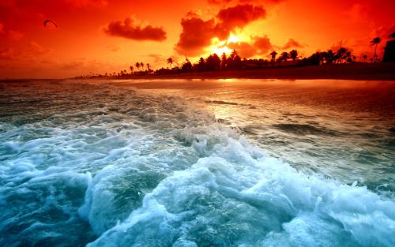
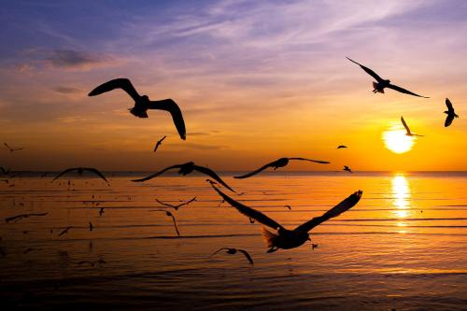
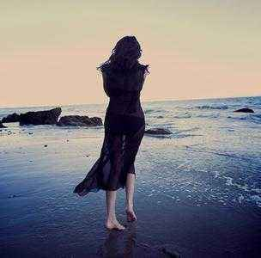
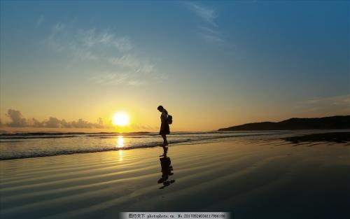
Detailed description of surroundings
A soft breeze gently kissed her hair. The golden red sun was setting. She was spellbound by its color, softly fading into yellow. She could hear nothing but the waves and the seagulls flying up above. The last sunshine gradually cast her shadow on the beach, leaving a long and charming figure in sight.

Slide 11

Application of detailed description
杰克和妈妈争吵之后离家出走。独自在街道上游荡，身无分文，饥饿难耐。偶遇一位热心老板，免费给他一碗面条。感激之情，难以言表。而老板说，“最应该感谢的是你的妈妈。”杰克意识到自己的错误，决定回家向妈妈道歉。请运用环境描写、动作描写和心理描写等设计一段杰克在见到妈妈之前的描写，首句已给出。
Darkness increased and Jack made his way towards the house.________________________________________________________________________________________________________________________________________________

Slide 12
Application of detailed description
Darkness increased and he made his way towards the house. Heart beating wildly and mind racing swiftly, he cautiously got closer, inch by inch, and hesitantly knocked on the door with a trembling hand. No answer. “Where could Mom have gone?” wondered Jack, confused. Then the seller’s words flashed across his mind again. Countless harsh winter dawns had witnessed mom rising early cooking breakfast for him. But never once had he said a single Thank You to her. Eyes glistening and throat tightening, he resolved to apologize to her. Then he felt a gentle touch on his head--

Slide 13
Reflecting on detailed description
To describe the surroundings and what people do.
To use specific vivid verbs and adverbs to describe actions.
To include people’s physical and mental response
by using sensory language.
To properly and naturally use dialogues.
To include mental activities.
---
How to give a detailed description?

Slide 14
自然环境描写
——描写波涛汹涌
The coastline was hidden behind the _________ waves (汹涌澎湃的浪涛)with almost no one to be seen.
roaring
2. As I floated on, ______________ (一个巨浪) _________(呼啸而来)and approached us.
a huge wave
whistled
3. The big wind ____________________(在耳边咆哮), and we
were pushed away from the shore farther and farther.
roared through our ears
4. All my senses told me that a big wave ________________.(即
将来临)
was about to come
5. A_______________(看似猛烈的)wave was ________________.
(靠近我们)
powerful-looking
coming towards us
6. The fierce waves _________________________(没有消退的迹象).
showed no sign of dying down

Slide 15
自然环境描写
——描写波涛汹涌
7. The sea was _________(汹涌的；风浪大的) that day and it
was difficult to ________(控制) the bodyboard.
rough
handle

Slide 16
人文环境描写
——描写声音传来
1. A distant sound _________________________.(传入耳朵)
reached our ears
2. A soft, reedy(似笛声的) sound ___________________________.
(漂浮在海上)
floated across the sea
3. The sound of the boat _______________________.(在我们耳内回响)
echoed in our ears
ripped /pierce into the air
4. At that moment, a shrill whistle(汽笛声)_________________ (划破天空).
5. When we were at a loss of what to do, there were rasping (刺耳的)
shouts(喊叫声) ____________________ (从远处升起).
rising from the distance
horn sounded
6. A ship's ____________________ (喇叭声响起).

Slide 17
人物描写
——描写疲倦
1. Drown in the sea, I______________ (失去了平衡) but seized the
bodyboard tightly.
lost my balance
engulfed/overwhelmed
2. Time passing us, tiredness _______________(包围了) us with my
feet __________ (僵硬/麻木)and shivering.
stiff/numb
3. ___________________ (尽管很累), we didn’t stop. Gritting out
teeth, we kept swimming.
Exhausted as we were
/fəˈtiːgd/
extremely fatigued
4. After what seemed a century, I felt _________________ (非常累)
while swimming hard to keep myself afloat(漂浮着的).
5. Casting a look at Tom, I could tell he was also ____________
_________________(明显地精 疲力尽了).
apparently
worn-out

Slide 18
人物描写
——描写害怕
1. I took a deep breath and_____________ (害怕地咽了口吐沫).
swallowed hard
2. Watching the shore in the distance, I felt _________ (无力的)
as if we were broken tiny boats at the mercy of strong wave.(simile)
powerless
3. Exhausted and cold, the thought that we might die here flashed
across my mind, which made me_____________________________
_______________________ (难以控制地发抖).
quiver with an uncontrollable terror/horror/fright
4. Looking at the vast sea, I felt a sense of fear ________________
______________.(在身体涌动)
surging through my
whole body
(creep)
5. As time ticked by, fear ___________________(爬上我心头)
and I could hardly tell how long I could _________(前行).
crept upon my heart
plough on

Slide 19
人物描写
——描写害怕
6. The thought of hopelessness _________________________(让
我后脊背发凉).
sent shivers down my spine
7. I was _________________________(被恐惧感淹没).
flooded with a sense of horror
8. Seeing this, I felt my fear ________________(剧增) inside.
growing/increasing
9. I felt ________________(一阵焦虑) _________________(袭来).
a wave of anxiety
swept over my body
sweep

Slide 20
人物描写
——描写挣扎努力
1. Tom looked ____________(若有所思)
thoughtful
2. “We need to think out a way!” I muttered (喃喃自语), ___________
_________(绞尽脑汁)
scratching
my head
3. ...,We swam ____________(全力以赴地).
tooth and nail
4. We __________________(不遗余力地) to swim towards the shore.
spared no effort to
5. We _________________________(互换了坚定的神情) , then
ploughed on (继续前行) __________________(难以置信的速度).
exchanged a determined look
at an incredible speed

Slide 21
人物描写
——描写如释重负
1. Ensuring their safety, I __________________ .(感到一阵胜利的喜悦)
felt a surge of triumph
2. Hearing the comforting news, I __________________________
_________________.(情难自抑)
couldn't help restraining my
excitement
3. _______________(听到...很高兴) to hear the good news.
It thrilled us
4. On hearing the good news, Tom and I _________________(如释重负地叹了口气), grinning merrily at each other.
sighed in great relief
5. ____________ (如释重负地微笑), I _________________(感到一阵自豪).
Smiling in relief
felt a rush of pride
6. _____________ (狂喜) to see a boat coming to our rescue, Tom and I ____________________ .(如释重负地松了口气)
Overjoyed
breathed a sigh of relief

Slide 22
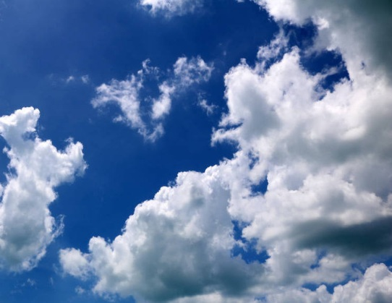
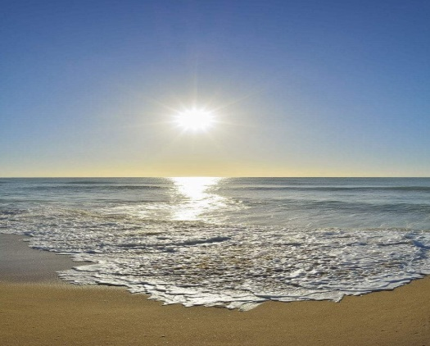

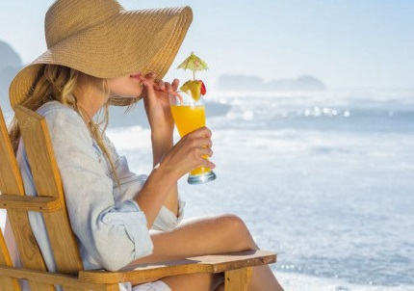
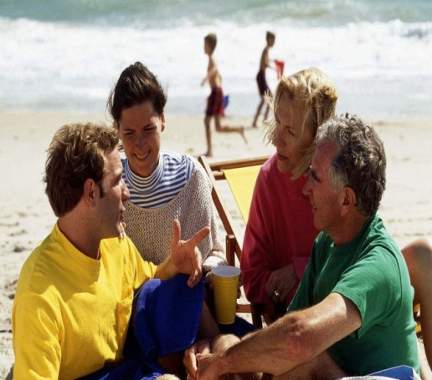
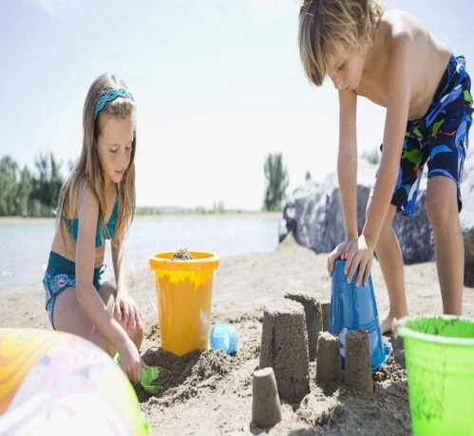

Outside the House (Para 1-2)
floating clouds
glistering water
scattered seashells
To give detailed description of the surroundings and what people do.
How does the author show they were having a perfect and relaxing holiday?

Slide 23




Continuation writing tips
Read more
Accumulate more
Imitate more
Acquire more

